Slide 1
Chapter 7: Batch processing and the Job Entry Subsystem (JES)
Batch processing and JES

Slide 2
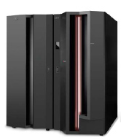
Chapter objectives
Be able to:
Give an overview of batch processing and how work is initiated and managed in the system.
Explain how the job entry subsystem (JES) governs the flow of work through a z/OS system.

Slide 3
Key terms in this chapter
batch processing
execution
initiator
job
job entry subsystem (JES)
output
procedure
purge
queue
spool
symbolic reference
workload manager (WLM)

Slide 4
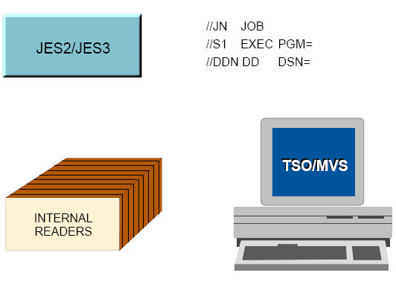
Job Management

Slide 5
What is batch processing?
Much of the work running on z/OS consists of programs called batch jobs.
Batch processing is used for programs that can be executed:
  With minimal human interaction
  At a scheduled time or on an as-needed basis.
After a batch job is submitted to the system for execution, there is normally no further human interaction with the job until it is complete.
Notes:
There is no direct counterpart to z/OS batch processing in PC or UNIX systems. Batch
processing is for those frequently used programs that can be executed with minimal
human interaction. They are typically executed at a scheduled time or on an as-needed
basis. Perhaps the closest comparison is with processes run by an AT or CRON command
in UNIX, although the differences are significant.
Work running on z/OS is called a job, and job control language or JCL is used to describe
certain attributes of the job to z/OS. A z/OS batch job consists of programs that run in
environments described by JCL. After the JCL is submitted to the system, there is
normally no further human interaction with the job until it is complete.

Slide 6
What is JES?
In the z/OS operating system, JES manages the input and output job queues and data.
JES handles the following aspects of batch processing for z/OS:
  Receives jobs into the operating system
  Schedules them for processing by z/OS
  Controls their output processing
Notes:
JES is the component of the operating system that provides supplementary job
management, data management, and task management functions such as scheduling,
control of job flow, and spooling.
z/OS has two versions of job entry systems: JES2 and JES3. Of these, JES2 is most
common by far and is used throughout this text.

Slide 7
What is JES? (continued)
z/OS offers two types: JES2 and JES3
Both JES2 and JES3:
  Accept and queue jobs submitted for execution
  Queue jobs for an initiator -- a JES program that requests the next job in the queue
  Accept output from a job while it is running and queue the output
  Can print the output, or save it on spool for an output manager to retrieve.

Slide 8
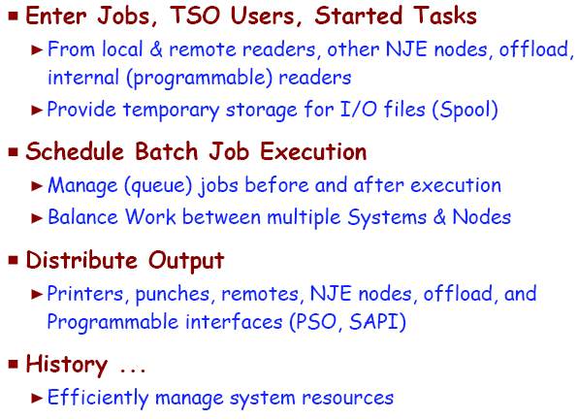
Why do we need JES

Slide 9
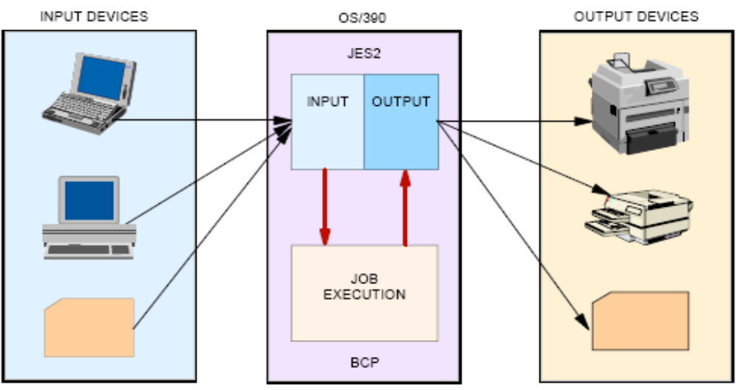
JES FUNCTIONS

Slide 10
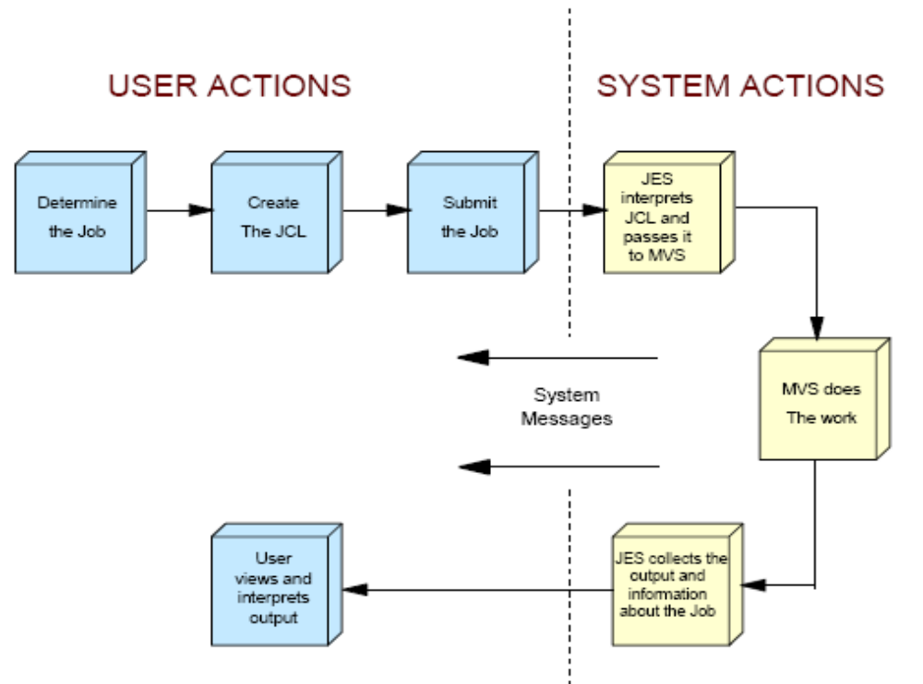
JCL Related Actions

Slide 11
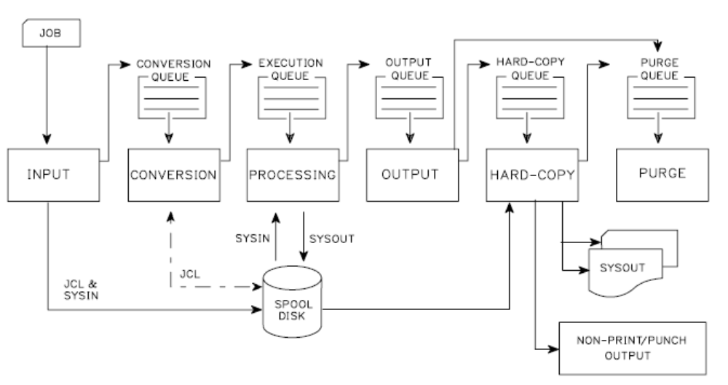
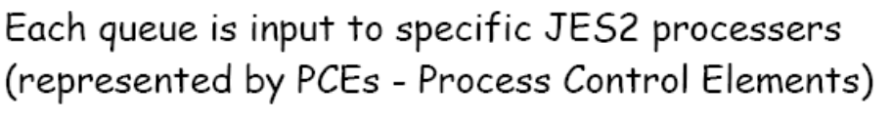
Phases of Job Processing

Slide 12
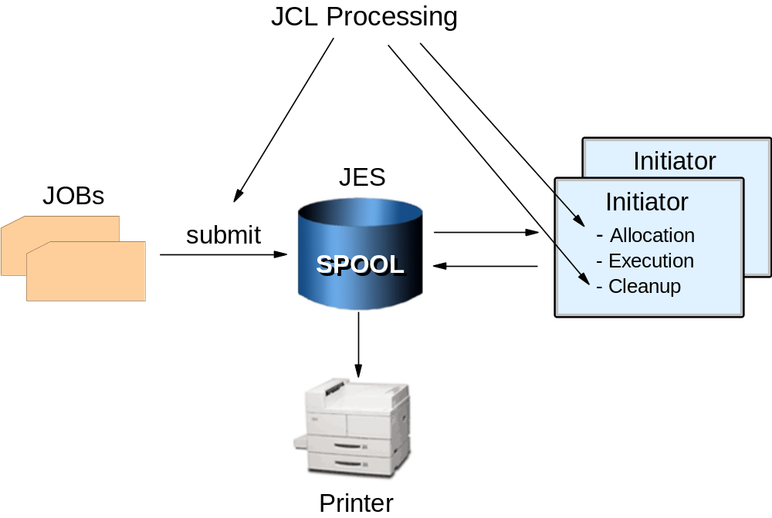
Batch flow (simplified)
Notes:
The initiator is an integral part of z/OS that reads, interprets, and executes the JCL. It is
normally running in several address spaces (as multiple initiators). An initiator manages
the running of batch jobs, one at a time, in the same address space. If ten initiators are
active (in ten address spaces), then ten batch jobs can run at the same time. JES does
some JCL processing, but the initiator does the key JCL work.
The jobs shown on the slide represent JCL and perhaps data intermixed with the
JCL. Source code input for a compiler is an example of data (the source statements) that
might be intermixed with JCL. Another example is an accounting job that prepares the
weekly payroll for different divisions of a firm (presumably, the payroll application
program is the same for all divisions, but the input and master summary files may differ).
The diagram represents the jobs as punched cards (using the conventional symbol for
punched cards) although real punched card input is very rare now.

Slide 13
What is spooling?
Spooling is a method for queuing and holding data for input or output.
JES uses one or more disk data sets for spooling.
Input jobs and printed output from many jobs are stored in the single (conceptual) spool data set.
Notes:
JES uses one or more disk data sets for spooling. JES combines multiple spool data sets
(if present) into a single conceptual data set. The internal format is not in a standard
access-method format and is not written or read directly by applications. Input jobs and
printed output from many jobs are stored in the single (conceptual) spool data set. In a
small z/OS system the spool data sets might be a few hundred cylinders of disk space; in
a large installation they might be many complete volumes of disk space.
Spool simply means to queue and hold data in card-image format (for input) or printed
format (for output).

Slide 14
What an initiator does
To run multiple jobs asynchronously, z/OS uses initiators to:
  Ensure that jobs do not conflict in data set usage
  Ensure that single-user devices (tape drives) are allocated correctly
  Find executable programs requested by jobs
  Clean up after the job ends and request the next job
Preventing two users from accessing the same data at the same time is critical to z/OS and the ability to do this is one of the defining characteristics of the operating system.
Notes:
To run multiple jobs asynchronously, the system must perform a number of functions:
Select jobs from the input queues (JES does this).
Ensure that multiple jobs (including TSO users and other interactive applications) do
not conflict in data set usage.
Ensure that single-user devices, such as tape drives, are allocated correctly.
Find the executable programs requested for the job.
Clean up after the job ends and then request the next job.
Most of this work is done by the initiator, based on JCL information for each job. The
most complex function is to ensure there are no conflicts due to data set utilization. For
example, if two jobs try to write in the same data set at the same time (or one reads while
the other writes), there is a conflict. This event would normally result in corrupted data.
The primary purpose of JCL is to tell an initiator what is needed for the job.
If job A and job B must both write to a particular data set, the system (through the initiator) does not permit
both jobs to run at the same time. Instead, whichever job starts first causes an initiator
attempting to run the other job to wait until the first job completes.

Slide 15
Symbolic references to files
z/OS normally uses symbolic references (DDNAMEs) to files (data sets) rather than actual file names.
The use of symbolic references provides a naming redirection between a data set-related name used in a program and the actual data set used during execution of that program.

Slide 16
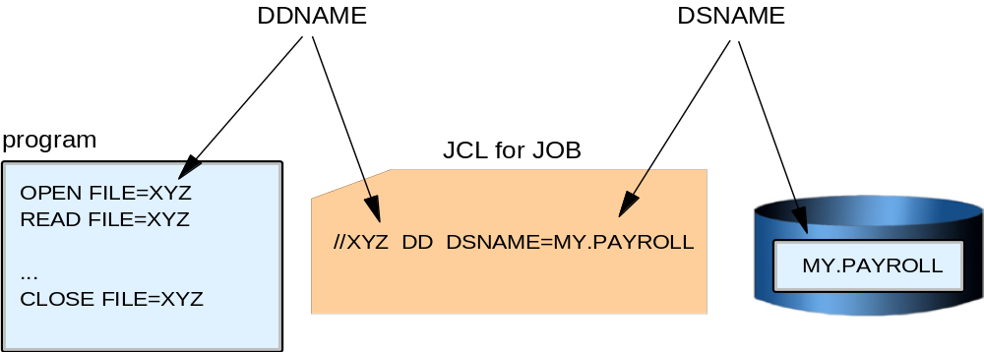
How a symbolic file system is used
Notes:
In this illustration we have a program that wants to open and read a data set.
When the program is written, the name XYZ is coded to reference the data set.
The program can be compiled and stored as an executable. When
someone wants to run the executable program, a JCL statement must be supplied that
connects the name XYZ to an actual data set name. This JCL statement is a data definition (DD) statement.
The symbolic name used in the program is a DDNAME and the real name of the data set
is a DSNAME.
The program can be used to process different input data sets simply by changing the
DSNAME on the XYZ DD card in the JCL. This becomes significant for large commercial applications that
might use dozens of data sets in a single execution of the program.

Slide 17
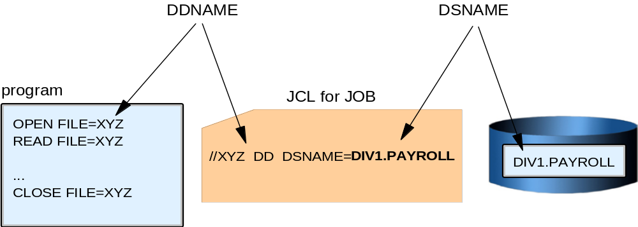
How a symbolic file system is used (continued)
Notes:
A payroll program for a large corporation is a good example. This can be an exceptionally complex application
that might use hundreds of data sets. The same program might be used for different
divisions in the corporation by running it with different JCL. Likewise, it can be tested
against special test data sets by using a different set of JCL.
The firm could use the same company-wide payroll application program for different
divisions and only change a single parameter in the JCL card (the
DD DSN=DIV1.PAYROLL). The parameter value DIV1.PAYROLL would cause the
program to access the data set for Division 1. This example demonstrates the power and
flexibility afforded by JCL and symbolic data set names.

Slide 18
JES, job management, and JCL
Job control language (JCL) is the language used by a batch job to request resources and services from the operating system.
Through JCL, you specify:
  Who you are (important for security reasons).
  Which resources (programs, files, memory) and services are needed from the system to process your program.

Slide 19
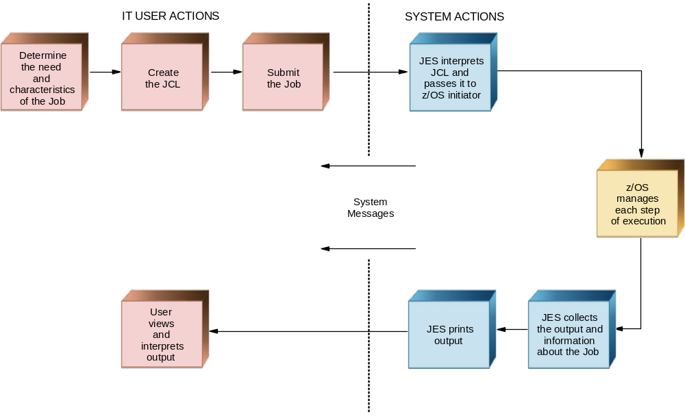
Related actions with JCL
Notes:
Imagine that you are a z/OS application programmer and you are developing a program
for a non-skilled users. Your program is supposed to read a couple of files, write another
couple, and then produce a printed report. This program will run as a batch job on z/OS.
What sorts of functions are needed in the operating system to fulfill the requirements of
your program? And, how will your program access those functions?
First, you need a sort of special language to inform the operating system about your
needs. On z/OS, this is Job Control Language (JCL). The use of JCL is covered in detail
in Chapter 6, “Using JCL” , but for now assume that JCL provides the means for you to
request resources and services from the operating system for a batch job.
Specifications and requests you might make for a batch job include the functions you
need to compile and execute the program, and allocate storage for the program to use as it
runs.
Think of JES as the manager of the jobs waiting in a queue. It manages the priority of the
set of jobs and their associated input data and output results. The initiator uses the
statements on the JCL cards to specify the resources required of each individual job once
it has been released (dispatched) by JES.
Your JCL stream is called a job—in this case formed by two sequential steps, the
compilation and execution. The steps in a job are always executed sequentially. The job
must be submitted to JES in order to be executed. In order to make your task easier, z/OS
provides a set of procedures in a data set called SYS1.PROCLIB. A procedure is a set of
JCL statements that are ready to be executed.

Slide 20
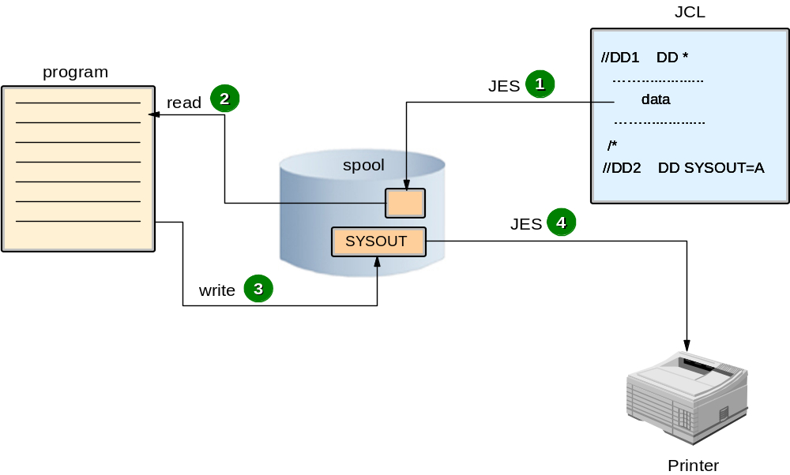
Spooling
Notes:
Spooling is the means by which the system manipulates its work, including:
Using storage on direct access storage devices (DASD) as buffer storage to reduce
processing delays when transferring data between peripheral equipment and a
program to be run.
Reading and writing input and output streams on an intermediate device for later
processing or output.
Performing an operation such as printing while the computer is busy with other work.
There are two sorts of spooling: input and output. Both improve the performance of the
program reading the input and writing the output.
To implement input spooling in JCL, you declare // DD *, which defines one file whose
content records are in JCL between the // DD * statement and the /* statements. All the
logical records must have 80 characters. In this case this file is read and stored in a
specific JES2 spool area (a huge JES file on disk) as shown on this slide.
Later, when the program is executed and asks to read this data, JES2 picks up the records
in the spool and delivers them to the program (at disk speed).
To implement output spooling in JCL, you specify the keyword SYSOUT on the DD
statement. SYSOUT defines an empty file in the spool, allocated with logical records of
132 characters in a printed format (EBCDIC/ASCII/UNICODE). This file is allocated by
JES when interpreting a DD card with the SYSOUT keyword, and used later for the step
program. Generally, after the end of the job, this file is printed by a JES function.

Slide 21
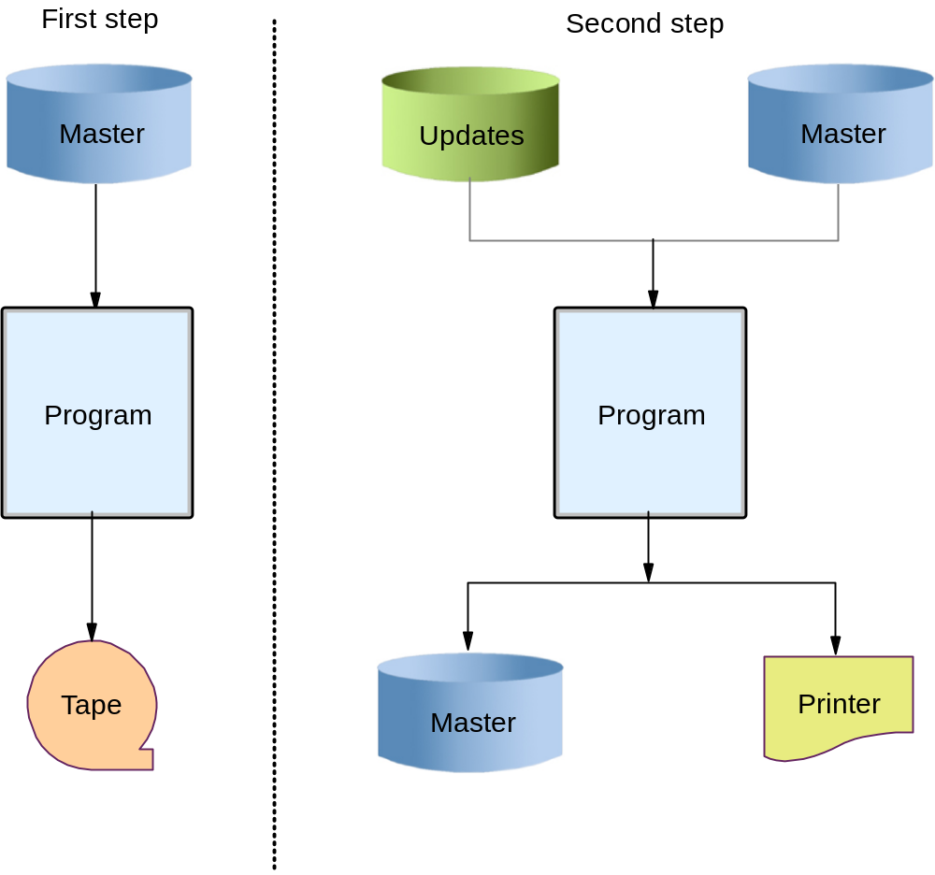
Two-step job
Notes:
Suppose now that you want to make a backup of one master file and then update the
master file with records read-in from another file (the update file). If so, you need a job
with two steps. In Step 1, your job reads the master file, and writes it to tape. In Step 2,
another program (which can be written in COBOL) is executed to read a record from the
update file and searches for its match in the master file. The program updates the existing
record (if it finds a match) or adds a new record if needed.
Your JCL must have two steps, the first one indicating the resources for the backup
program, and the second for the update program.
Logically, the second step will not be executed if the first one fails for any reason. The
second step will have a // DD SYSOUT statement to indicate the need for output spooling.
The jobs are only allowed to start when there are enough resources available. In this way,
the system is made more efficient: JES manages jobs before and after running the
program; the base control program manages jobs during processing.

Slide 22
Job flow through the system
During execution, a job goes through the following phases:
  Input
  Conversion
  Processing
  Output
  Print (to hardcopy or a console display)
  Purge
Notes:
During the life of a job, JES2 and the base control program of z/OS control different
phases of the overall processing. The job queues contain jobs that are waiting to run,
currently running, waiting for their output to be produced, having their output produced,
and waiting to be purged from the system.

Slide 23
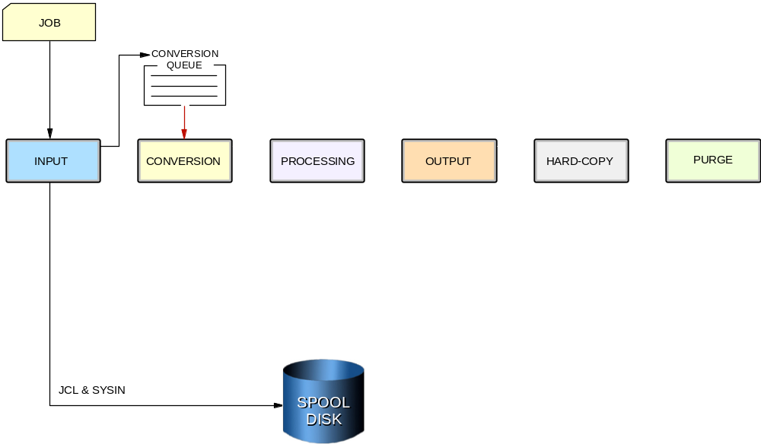
Phases of job flow: input
Notes:
Input phase
JES2 accepts jobs, in the form of an input stream, from input devices, from other
programs through internal readers, and from other nodes in a job entry network.
The internal reader is a program that other programs can use to submit jobs, control
statements, and commands to JES2. Any job running in z/OS can use an internal
reader to pass an input stream to JES2. JES2 can receive multiple jobs simultaneously
through multiple internal readers.
The system programmer defines internal readers to be used to process all batch jobs
other than started Tasks (STCs) and TSO requests.
JES2 reads the input stream and assigns a job identifier to each JOB JCL statement.
JES2 places the job’s JCL, optional JES2 control statements, and SYSIN data onto
DASD data sets called spool data sets. JES2 then selects jobs from the spool data sets
for processing and subsequent running.

Slide 24
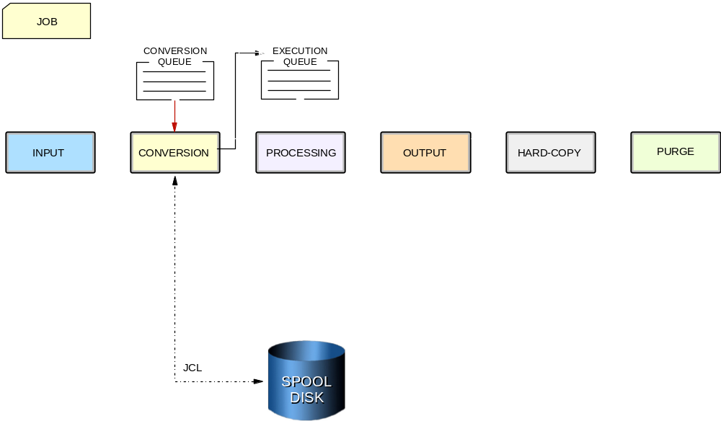
Phases of job flow: conversion
Notes:
Conversion phase
JES2 uses a converter program to analyze a job’s JCL statements. The converter takes
the job’s JCL and merges it with JCL from a procedure library. The procedure library
can be defined in the JCLLIB JCL statement, or system/user procedure libraries can
be defined in the PROCxx DD statement of the JES2 startup procedure. Then, JES2
converts the composite JCL into converter/interpreter text that both JES2 and the
initiator can recognize. Next, JES2 stores the converter/interpreter text on the spool
data set. If JES2 detects any JCL errors, it issues messages, and the job is queued for
output processing rather than execution. If there are no errors, JES2 queues the job for
execution.

Slide 25
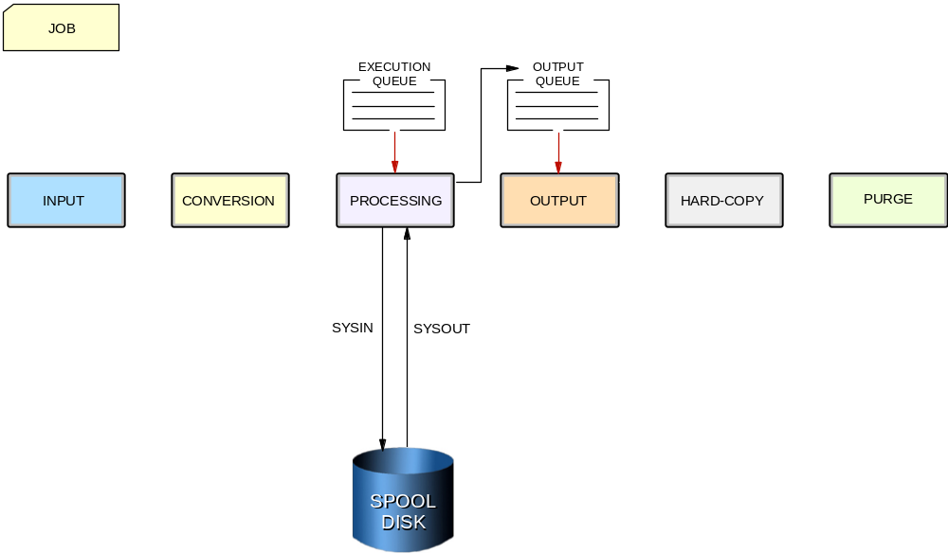
Phases of job flow: execution
Notes:
Processing or execution phase
In the processing phase, JES2 responds to requests for jobs from the initiators. JES2
selects jobs that are waiting to run from a job queue and sends them to initiators.
An initiator is a system program belonging to z/OS, but controlled by JES or by
workload manager (WLM) that starts a job allocating the required resources to allow
it to compete with other jobs that are already running (WLM is described later in this module).
JES2 initiators are initiators that are started by the operator or by JES2 automatically
when the system initializes. They are defined to JES2 through JES2 initialization
statements. The installation associates each initiator with one or more job classes in
order to obtain an efficient use of available system resources. initiators select jobs
whose classes match the initiator-assigned class, obeying the priority of the queued
jobs.
WLM initiators are started by the system automatically based on performance goals,
relative importance of the batch workload, and the capacity of the system to do more
work. The initiators select jobs based on their service class and the order they were
made available for execution. Jobs are routed to WLM initiators through a
JOBCLASS JES2 initialization statement.

Slide 26
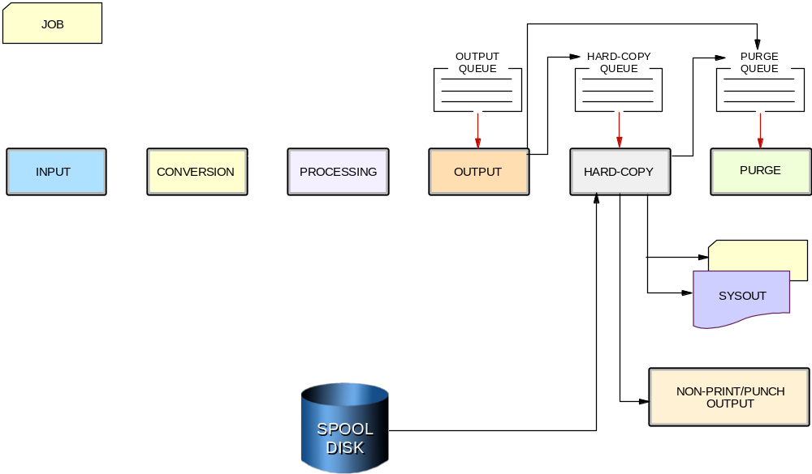
Phases of job flow: output and hardcopy
Notes:
Output phase
JES2 controls all SYSOUT processing. SYSOUT is system-produced output; that is,
all output produced by, or for, a job. This output includes system messages that must
be printed, as well as data sets requested by the user that must be printed or punched.
After a job finishes, JES2 analyzes the characteristics of the job’s output in terms of
its output class and device setup requirements; then JES2 groups data sets with
similar characteristics. JES2 queues the output for print or punch processing.
Hardcopy phase
JES2 selects output for processing from the output queues by output class, route code,
priority, and other criteria. The output queue can have output that is to be processed
locally or at a remote location. After processing all the output for a particular job,
JES2 puts the job on the purge queue.

Slide 27
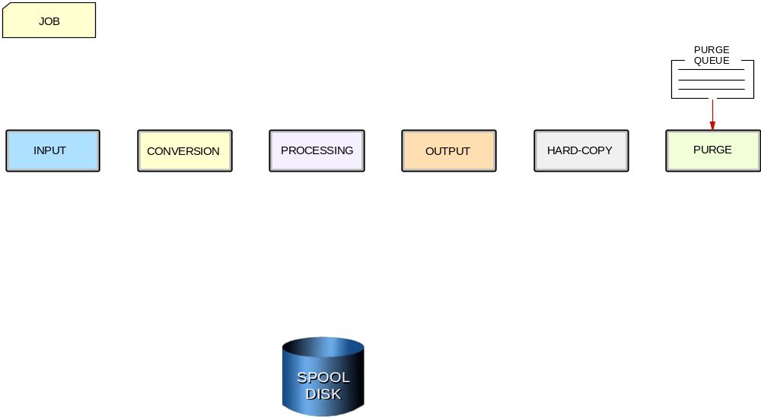
Phases of job flow: purge
Notes:
Purge phase
When all processing for a job completes, JES2 releases the spool space assigned to
the job, making the space available for allocation to subsequent jobs. JES2 then issues
a message to the operator indicating that the job has been purged from the system.

Slide 28
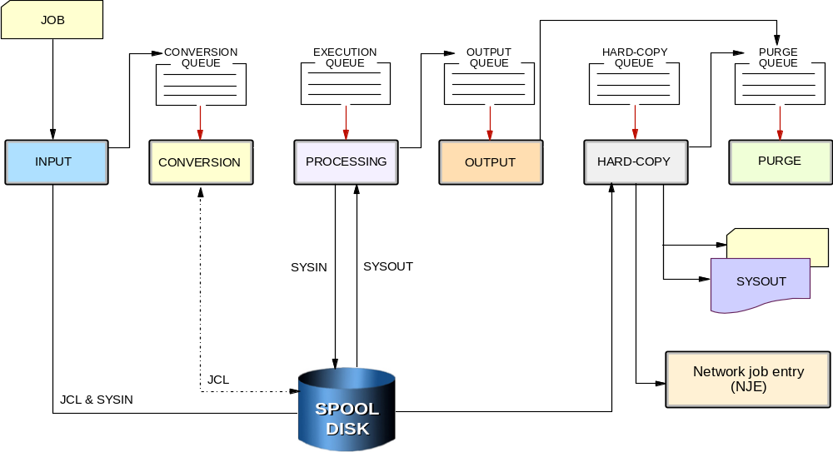
Job flow through the system

Slide 29
JES2 compared to JES3
In a multi-processor configuration:
JES2:
  Each JES2 processor controls its own job input, job scheduling, and job output processing.
  It is possible to configure JES2 to share spool and checkpoint data sets with other JES2 systems (multi-access spool or MAS).
JES3:
  Centralized control over processing through a single global JES3 processor, which does job selection, scheduling, and device allocation the other JES3 systems.
  The centralized control of JES3 provides increased job scheduling control, deadline scheduling capabilities, and increased control by providing its own device allocation.
Most installations use JES2.
Notes:
As previously mentioned, IBM provides two kinds of job entry subsystems: JES2 and
JES3. In many cases, JES2 and JES3 perform similar functions. They read jobs into the
system, convert them to internal machine-readable form, select them for processing,
process their output, and purge them from the system.
In an installation with a multi-processor configuration, there are noticeable differences
between the two, mainly in how JES2 exercises independent control over its job
processing functions. That is, within the configuration, each JES2 processor controls its
own job input, job scheduling, and job output processing.

Slide 30
What is workload manager?
Workload manager (WLM):
The component of z/OS that manages the processing of workload in the system according to the company’s business goals, such as response time.
Also manages the use of system resources, such as processors and storage, to accomplish these goals.
Notes:
Before the introduction of WLM, the only way to inform z/OS about the company’s
business goals was for the system programmer to translate from high-level objectives
about what work needs to be done into the extremely technical terms that the system can
understand. This translation required highly skilled staff, and could be protracted,
error-prone, and eventually in conflict with the original business goals.
Further, it was often difficult to predict the effects of changing a system setting, which
might be required, for example, following a system capacity increase. This could result in
unbalanced resource allocation, that is, feeding work one resource while starving it of
another. This way of operation, known as compatibility mode, was becoming
unmanageable as new workloads were introduced, and as multiple systems were being
managed together in parallel sysplex processing and data sharing environments.
When in goal mode system operation, WLM provides fewer, simpler, and more
consistent system externals that reflect goals for work expressed in terms commonly used
in business objectives, and WLM and Service Request Manager (SRM) match resources
to meet those goals by constantly monitoring and adapting the system. Workload
Manager provides a solution for managing workload distribution, workload balancing,
and distributing resources to competing workloads.

Slide 31
Summary
Batch processing is a fundamental function of z/OS.
z/OS shares with JES the management of jobs and resources.
JES receives jobs into the system, schedules them for processing, and controls their output.
JES manages jobs in queues.
An initiator sets up the necessary environment for running a batch job. Multiple initiators permit the parallel execution of batch jobs.
During the life of a job, both JES and the z/OS base control program control different phases of the overall processing.
Notes:
Many batch jobs are usually
run in parallel and JCL is used to control the operation of each job. Correct use of JCL
parameters (especially the DISP parameter in DD statements) allows parallel,
asynchronous execution of jobs that may need access to the same data sets.
An initiator is a system program that processes JCL, sets up the necessary environment
in an address space, and runs a batch job in the same address space. Multiple initiators
(each in an address space) permit the parallel execution of batch jobs.
A goal of an operating system is to process work while making the best use of system
resources. To achieve this goal, resource management is needed during key phases:
Before job processing, reserve input and output resources for jobs
During job processing, manage spooled SYSIN and SYSOUT data
After job processing, free all resources used by the completed jobs, making the
resources available to other jobs.
z/OS shares with JES the management of jobs and resources. JES receives jobs into the
system, schedules them for processing by z/OS, and controls their output processing. JES
is the manager of the jobs waiting in a queue. It manages the priority of the jobs and their
associated input data and output results. The initiator uses the statements in the JCL
records to specify the resources required of each individual job after it is released
(dispatched) by JES.
During the life of a job, both JES and the z/OS base control program control different
phases of the overall processing. Jobs are managed in queues: Jobs that are waiting to run
(conversion queue), currently running (execution queue), waiting for their output to be
produced (output queue), having their output produced (hard-copy queue) and waiting to
be purged from the system (purge queue).

